Slide 1


t2linux: Linux on 2018+ Intel Macs
t2linux team

Slide 2
Introductions
Woohyun Cho (NoaHimesaka1873): Arch Linux maintainer for t2linux
Mark Vainomaa (mikroskeem): NixOS maintainer for t2linux
networkException: Wiki maintainer for t2linux
Sorry, no Ubuntu maintainers here because they’re all busy
UbuCon Asia 2022 | t2linux: Linux on 2018+ Intel Macs

Slide 3
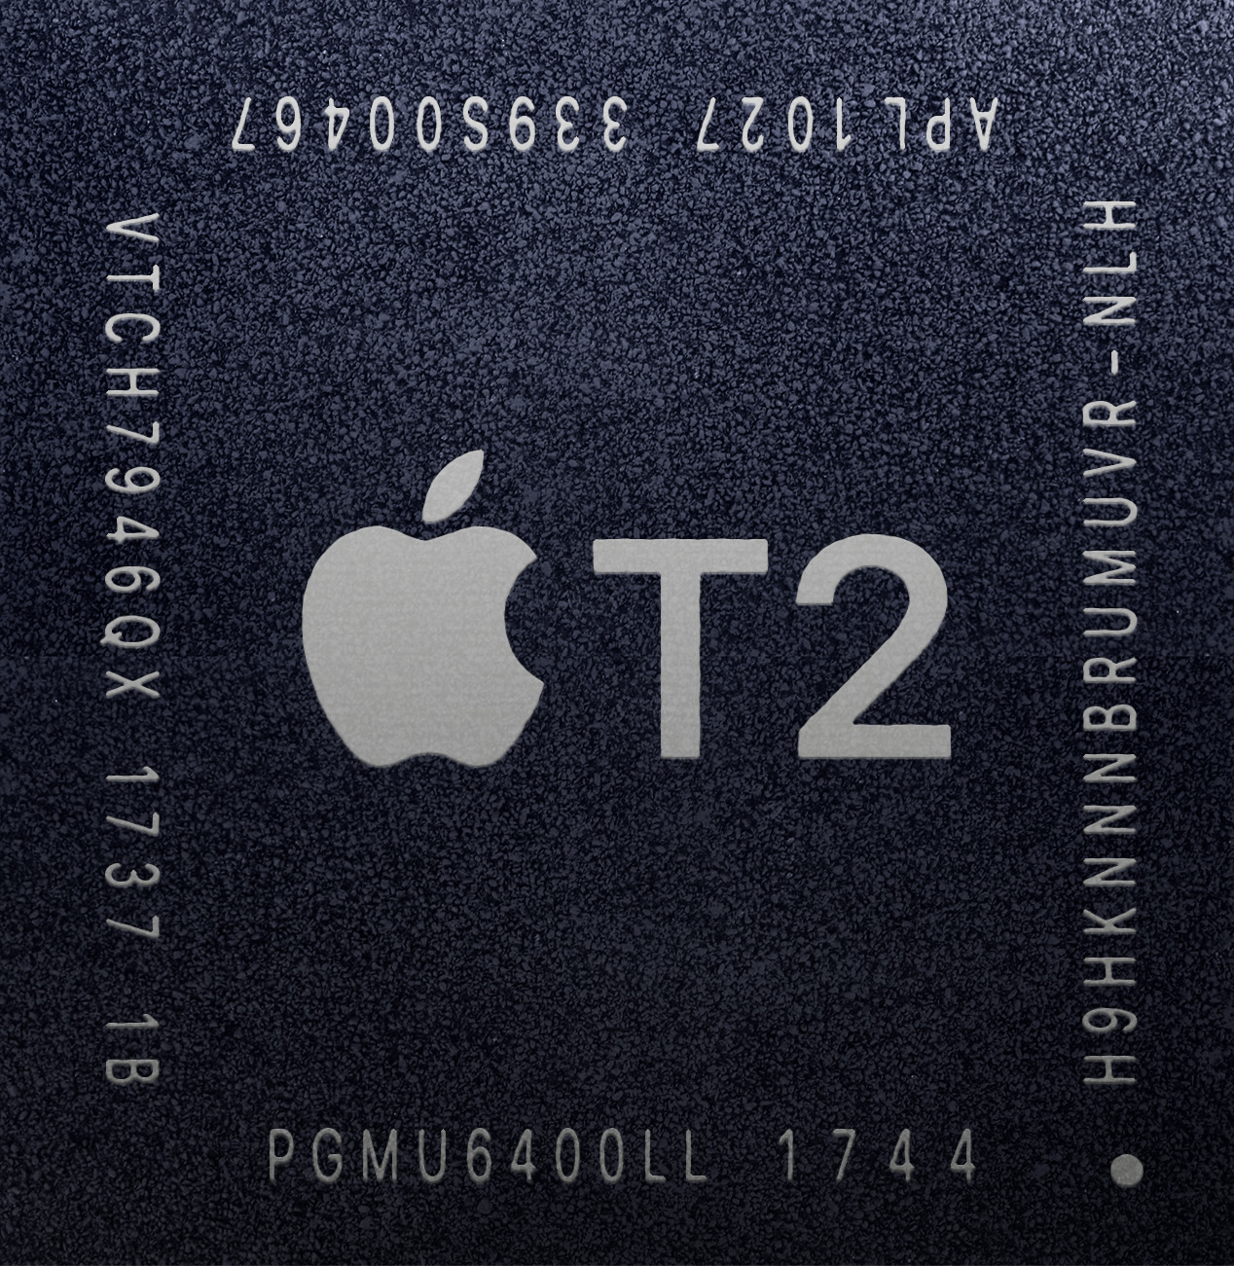
Your PC vs T2 Mac
Apple T2 is a security chip incorporated in 2018+ Macs
Controls most of Mac’s hardware including SSD, camera, microphone, etc
Based on Apple A10
Drivers only for macOS and Windows, no official support for Linux
Picture of Apple T2
UbuCon Asia 2022 | t2linux: Linux on 2018+ Intel Macs

Slide 4
How we made it work
We have to deal with mostly undocumented chip
Fortunately, there’s Windows driver so we could reverse-engineer
Early efforts from aunali1, rodarunner2, McMrARM, enabling basic keyboard, mouse, and Touch Bar support
t2linux was created in 2020
Wi-fi supported was added around 2020
We have made some progress, but we’re far from perfect
UbuCon Asia 2022 | t2linux: Linux on 2018+ Intel Macs

Slide 5
Demo
Well, you gotta see the real thing running Ubuntu
UbuCon Asia 2022 | t2linux: Linux on 2018+ Intel Macs

Slide 6
Introductions
[Content here]
UbuCon Asia 2022 | t2linux: Linux on 2018+ Intel Macs

Slide 7
Thank you!

